Slide 1
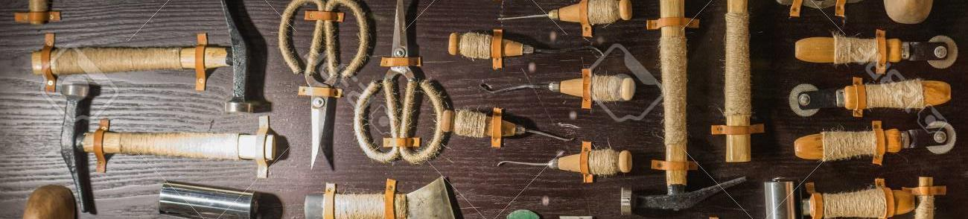
Surviving
It’s (probably) not
as bad as you think
Legacy {code}
SOFTWARE CRAFTSMANSHIP
Desire to be proud of what we do

Slide 2
prelude
What is legacy code?

Slide 3
wikipedia claims as the original definition
“Code for an obsolete computer”
Notes:
What Wikipedia claims as the original definition

Slide 4
most current definition
“Code inherited from someone else”
Notes:
Sounds familiar? ….lol this seems to fairly accurate…but it has bust of problems
Lets see
On one occasion I inherited some code that was not legacy code.
On far more occasions, I found myself writing exciting new code legacy that was legacy even before it left my fingures

Slide 5
reality check 1
I inherited some code that was not legacy code
Notes:
Sounds familiar? ….lol this seems to fairly accurate…but it has bust of problems
Lets see
On one occasion I inherited some code that was not legacy code.
On far more occasions, I found myself writing exciting new code legacy that was legacy even before it left my fingures

Slide 6
reality check 2
I found myself writing exciting new legacy code that was legacy even before it left my fingers
Notes:
Sounds familiar? ….lol this seems to fairly accurate…but it has bust of problems
Lets see
On one occasion I inherited some code that was not legacy code.
On far more occasions, I found myself writing exciting new code legacy that was legacy even before it left my fingures

Slide 7
most visceral definition
“Code I am afraid to modify”
Notes:
This is probably the best definition that describes my state of mind
Because either it’s rigid or it’s fragile, or it’s not redable

Slide 8
more practical definition that points to a solution
“Code without tests”
Michael Feathers
Notes:
The guy who wrote an amazing book I think we all must read

Slide 9
another definition that I liked
“code that I don’t have confidence in!”
Werner Beytel
Notes:
The guy who wrote an amazing book I think we all must read

Slide 10
is there better way to look at legacy code?
when I say “legacy Code”
…I mean profitable code that we feel afraid to change.
J. B. Rainsberger
Notes:
All three things are important,
Profiltable-
Feel afraid & Change

Slide 11
is there better way to look at legacy code?
when I say “legacy Code”
…I mean profitable code that we feel afraid to change.
J. B. Rainsberger
Notes:
All three things are important,
Profitable – if it’s not profitable just throw it away. We need to respect it, its generating money or more business value
Feel afraid – if we don’t feel afraid it doesn’t matter. Familiarity affects our feeling. For some people the same code may not mean legacy because they are quite familiar with it
Change - we don’t have to change if it doesn’t matter. It stay where it is and we choose to sit and do what we like without bothering it.
Usually legacy code is all three of the things, it’s profiltable we feel afraid and we have to change

Slide 12

Write some tests
all done, lets go home
If only it were that easy

Slide 13
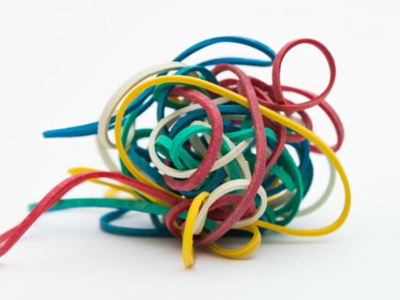
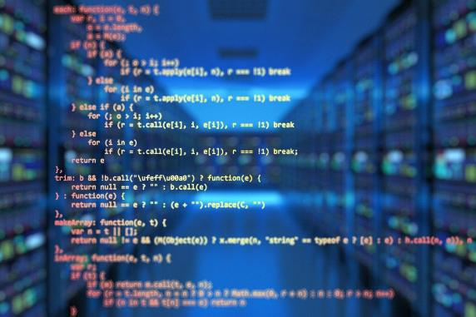
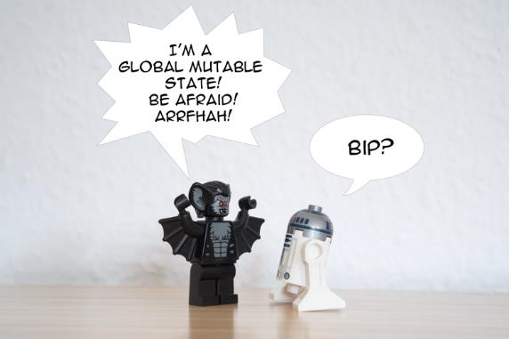
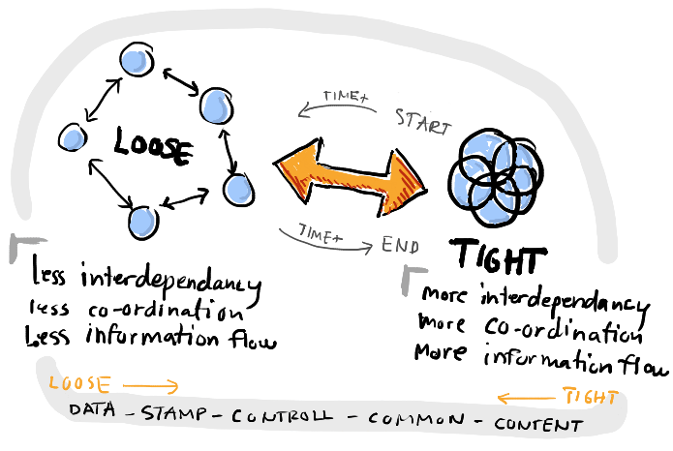
Why it’s not that easy?
Spaghetti
code
Gian
functions
Global mutable
state
Tightly coupled
dependencies
Notes:
https://thevaluable.dev/global-variable-explained/
Example for tight coupling…
Calling a function DB, making an api call log something…etc to test this function I may need two dbs…a third party api

Slide 14
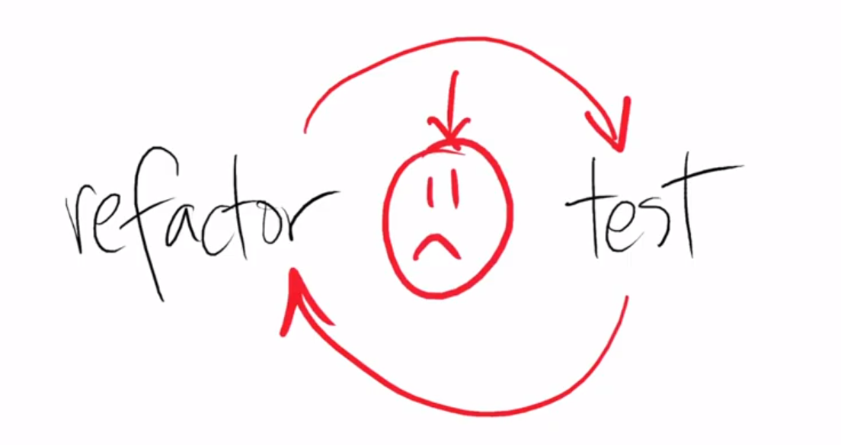
the central conflict of legacy code
Reference: J. B. Rainsberger
Notes:
We want to refactor the code in order to make it easier to change
But before you do that you want to add the tests so that we will be able to refactor safely
It’s feedback loop
So what can help us to manage this panic/conflict

Slide 15
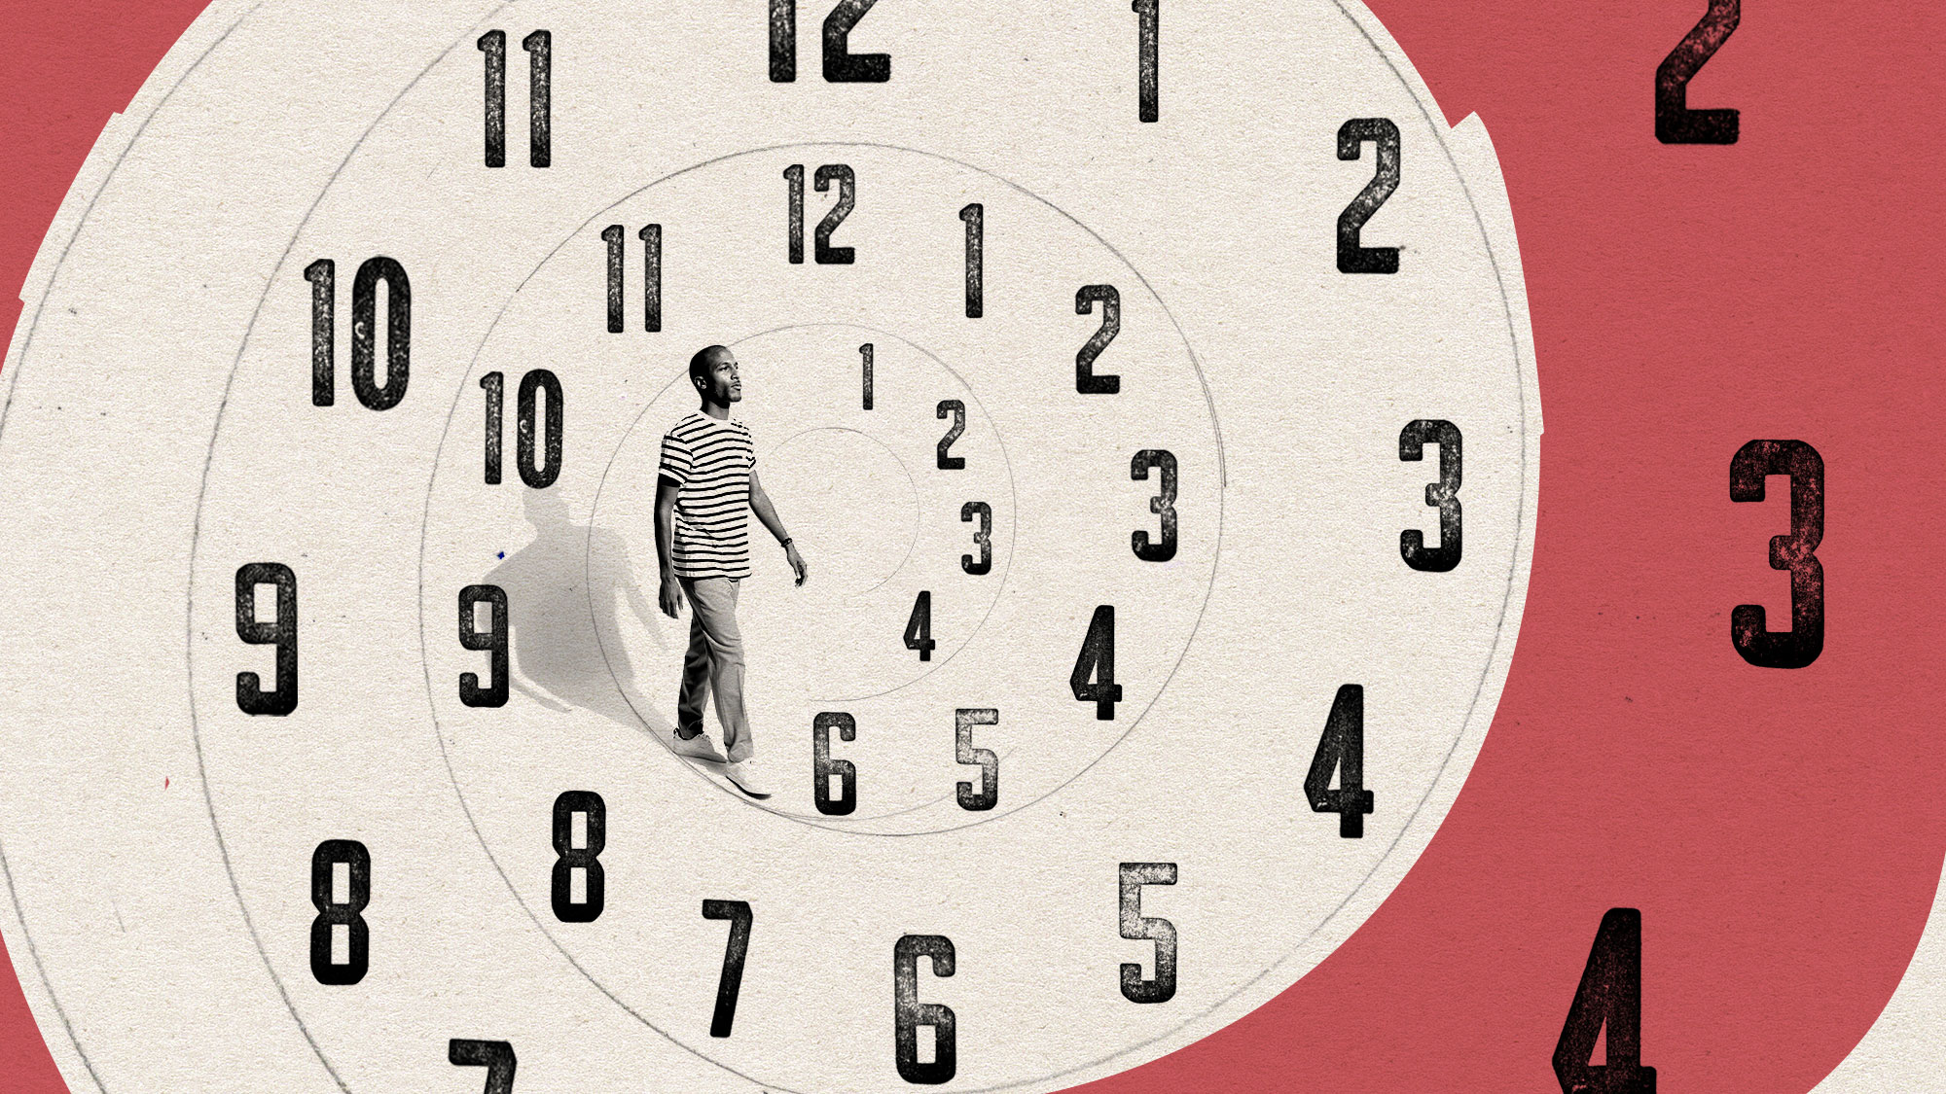
It get’s worse over time
“Neglection accelerates the rot faster than any other factor.”
Notes:
Changing legacy code is scary
It doesn’t get refactored
We fall for doing hacks

Slide 16
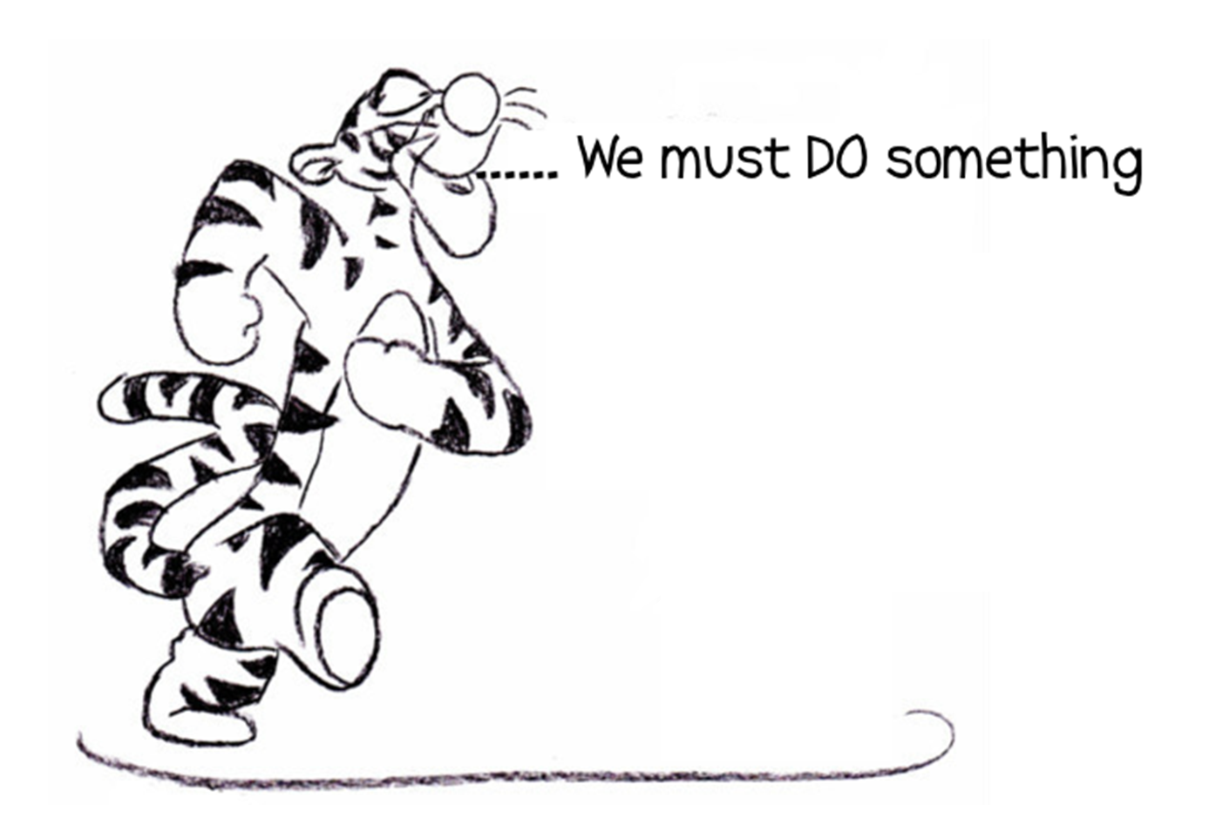

Slide 17
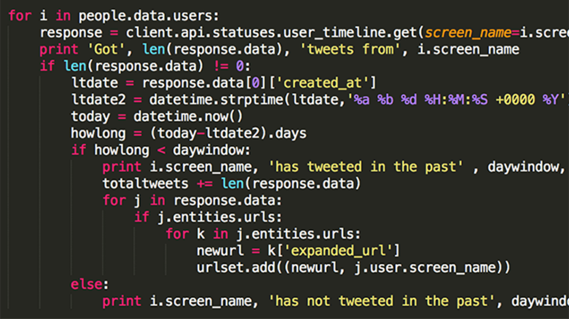
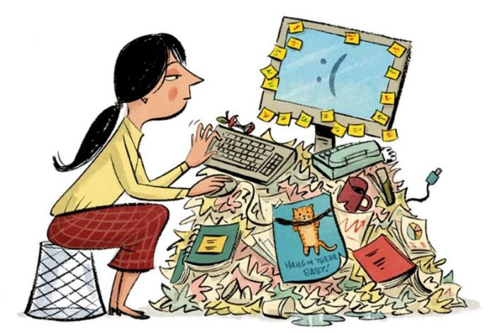

3 keys areas in Surviving legacy code
Rescue the code
Organize the work
Navigate the people
Reference: J. B. Rainsberger
Notes:
Rescue the code:
Organize the work : because the work is more chaotic, unplanned, in many cases it’s unplannable, it’s easy to get lost, We might get into a mode of chasing every rabbit you see, we are going to get distracted easily
Navigate the people : we all are different in many ways. When we work with legacy code, it’s going to be challenging interacting with people, managing stress levels, because legacy code is inherently uncertain.
Uncertanity brings uncomfort, defensiveness
Organize the work & Navigate the people is more important than other,
The best way to block the kick is not to be there

Slide 18
Surviving legacy code in a nutshell
Rescue the code
Organize the work
Navigate the people

Slide 19


Rescue the code
Stop making
it worse
Optimize for safety

Slide 20
Rescue the code
Stop making
it worse
Notes:
One of the simplest thing that we can do is use the legacy code as an example
A rich library of the examples of the things that we already know we don’t like it.
The things we agree with our team that we don’t like and use it as opportunity to show each other as why something is bad idea to do it that way.
Let’s agree to stop doing that. Let’s agree that even in moments of stress, when we feel deadline pressure and we have an urge to type something that works and forget about it.
We can point back to the code that we don’t like it or the one that annoys us.
We then can say..Hey we did that 120 places, let’s not make it 121

Slide 21
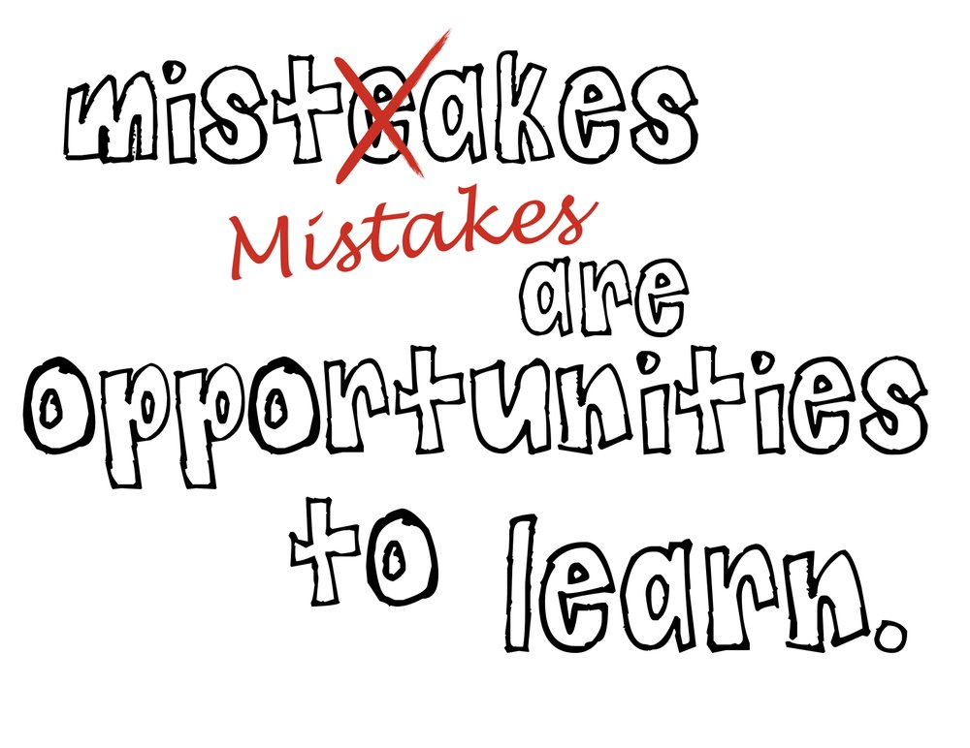

Slide 22
even if we don’t rescue the legacy code…
…use this as a rich set examples of what
we will not do
Notes:
One of the simplest thing that we can do is use the legacy code as an example
A rich library of the examples of the things that we already know we don’t like it.
The things we agree with our team that we don’t like and use it as opportunity to show each other as why something is bad idea to do it that way.
Let’s agree to stop doing that. Let’s agree that even in moments of stress, when we feel deadline pressure and we have an urge to type something that works and forget about it.
We can point back to the code that we don’t like it or the one that annoys us.
We then can say..Hey we did that 120 places, let’s not make it 121

Slide 23
Static analysis tools are your friends
Notes:
The guy who wrote an amazing book I think we all must read

Slide 24
Rescue the code
Optimize for safety

Slide 25
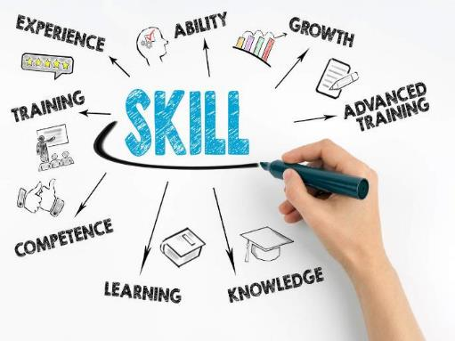

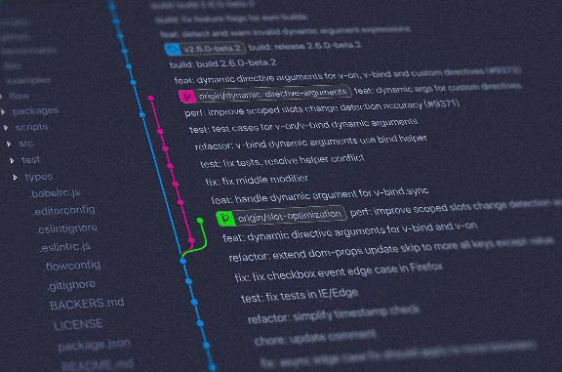
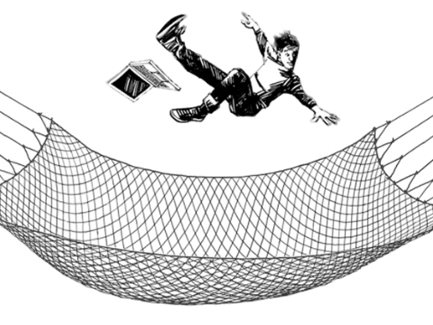
Optimize for safety
Build Skill
Get familiar
MICROCommitting
Safety net
Notes:
However of than you are doing it now, do it 2 or 3 times more.
Make small change, commit, make another change commit
The idea here is 2 things
1. When we are creating more commits, we are creating more undo spots in your change history

Slide 26


Slide 27
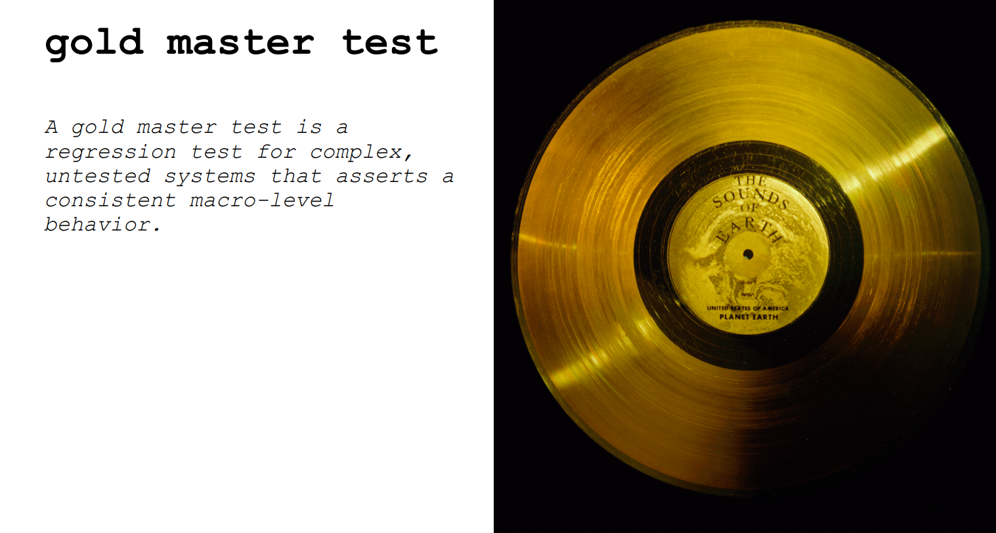

Slide 28
let’s
{code}
https://github.com/bharatmane/trivia-refactoring/commits/master

Slide 29

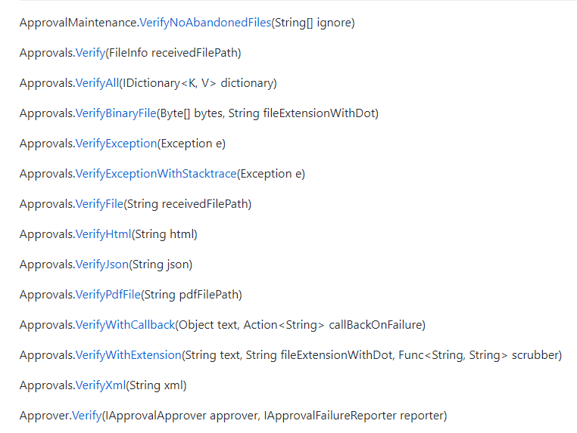
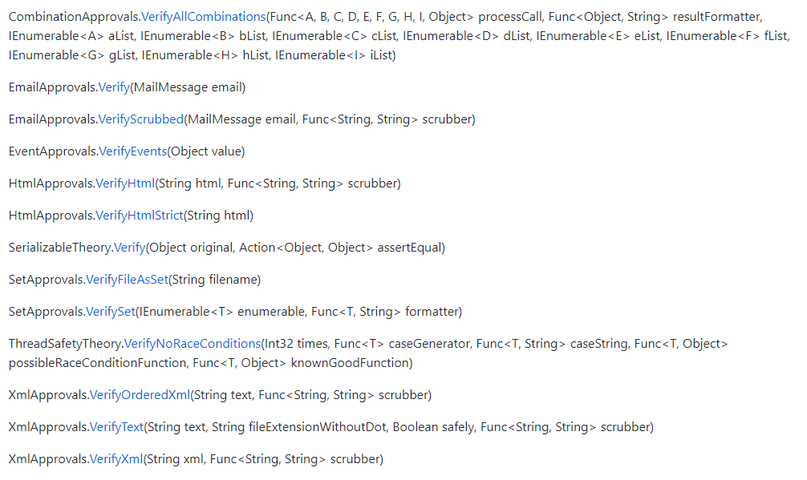
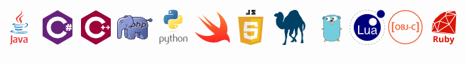
Approval Tests

Slide 30
tl;dr

Slide 31
more practical definition that points to a solution
“Code without tests”
Michael Feathers
Notes:
The guy who wrote an amazing book I think we all must read

Slide 32
is there better way to look at legacy code?
when I say “legacy Code”
…I mean profitable code that we feel afraid to change.
J. B. Rainsberger
Notes:
All three things are important,
Profitable – if it’s not profitable just throw it away. We need to respect it, its generating money or more business value
Feel afraid – if we don’t feel afraid it doesn’t matter. Familiarity affects our feeling. For some people the same code may not mean legacy because they are quite familiar with it
Change - we don’t have to change if it doesn’t matter. It stay where it is and we choose to sit and do what we like without bothering it.
Usually legacy code is all three of the things, it’s profiltable we feel afraid and we have to change

Slide 33
Neglection accelerates rot faster than any other factor

Slide 34
Optimize for safety
Build Skill
Get familiar
MICROCommitting
Safety net
Notes:
However of than you are doing it now, do it 2 or 3 times more.
Make small change, commit, make another change commit
The idea here is 2 things
1. When we are creating more commits, we are creating more undo spots in your change history

Slide 35
GOLDEN master
Approval Tests

Slide 36
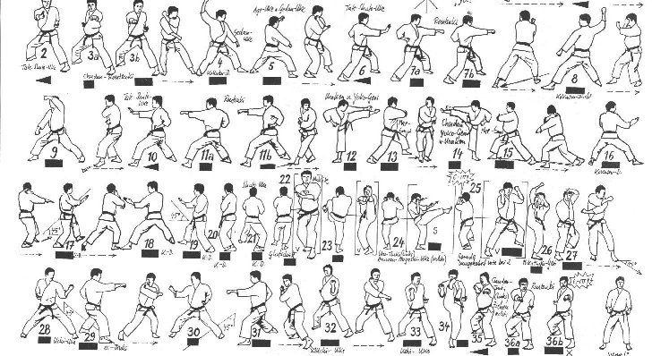
Practice
Practice
Practice

Slide 37
MINDSET
Want to do it

Slide 38
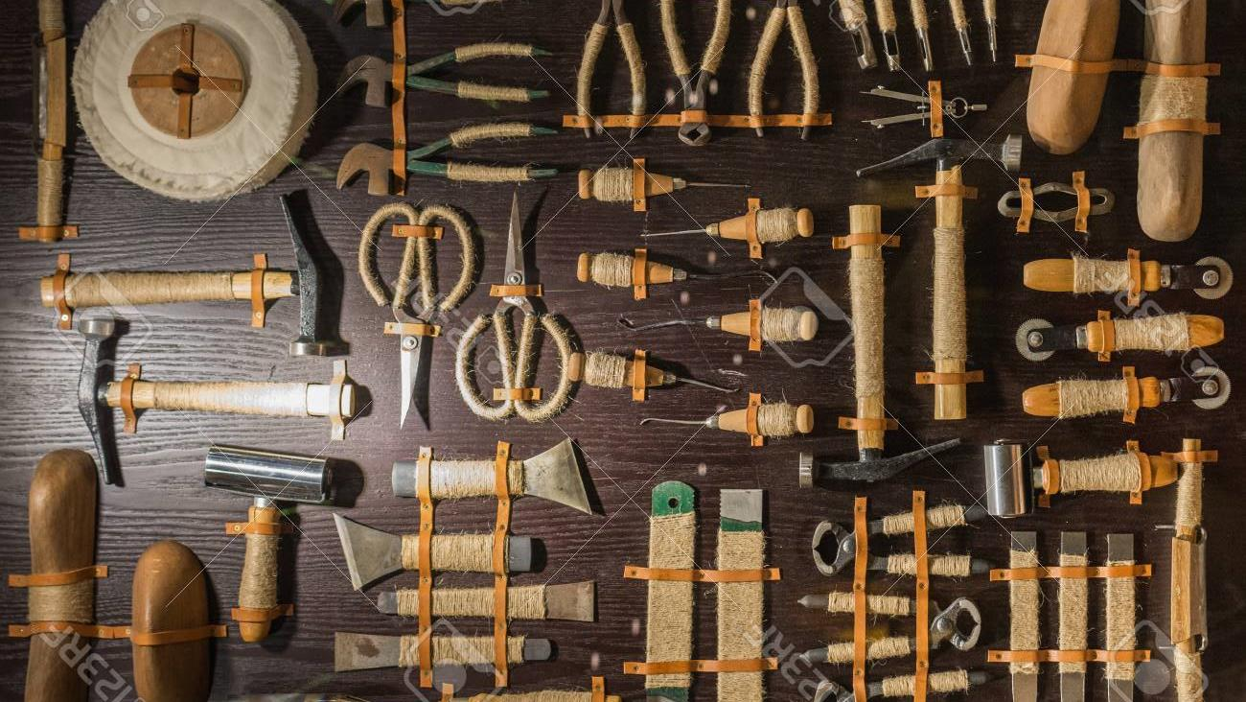
Q&A
Bharat
MANE

Slide 39
ANNEXTURE
Bharat
MANE

Slide 40
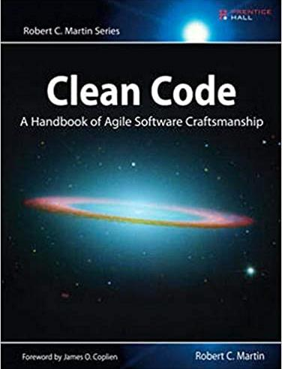
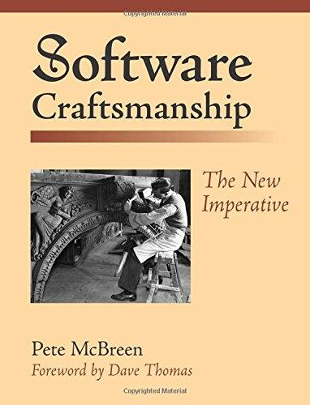
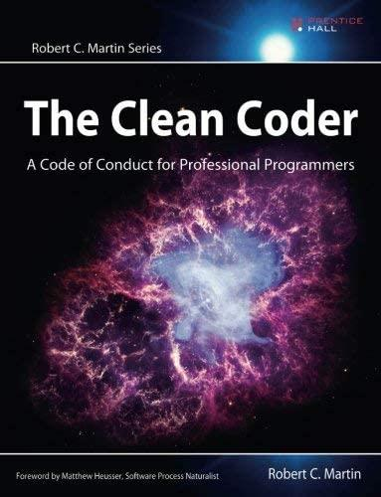
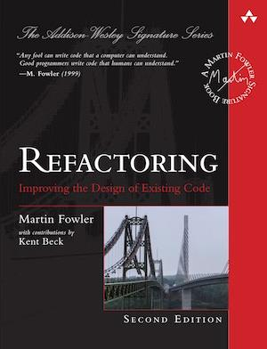
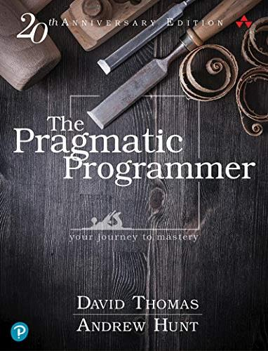
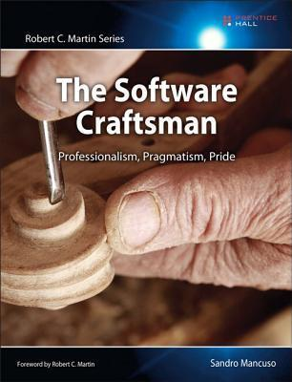
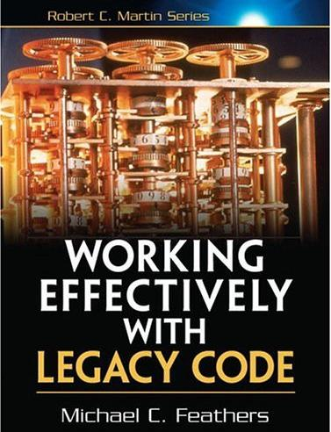
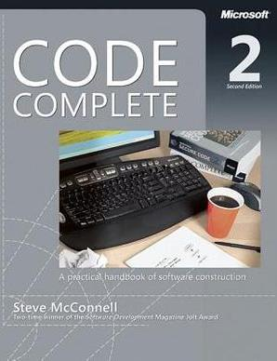

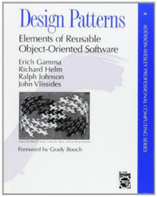
Good reads
Bharat
MANE

Slide 41
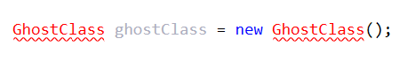
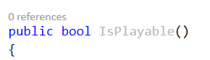
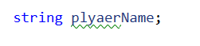
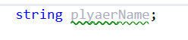
error warn typo unused
When it’s {red}, {yellow}, {green}, {gray}
Alt + Enter will save your day

Slide 42
SEAMS
“A seam is a place where you can alter behaviour in your program without editing in that place”
Michael Feathers
Notes:
The guy who wrote an amazing book I think we all must read

